Slide 1
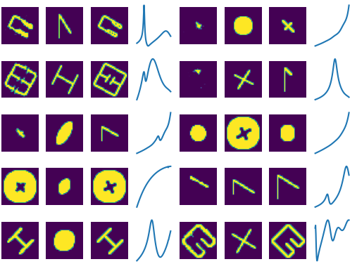
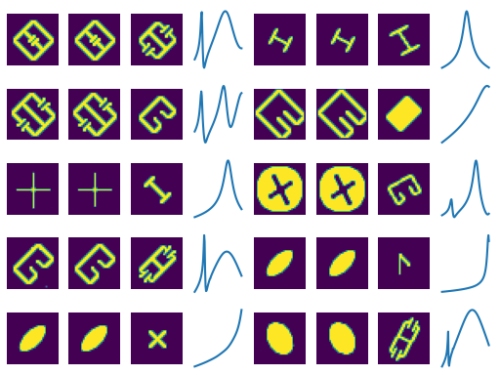
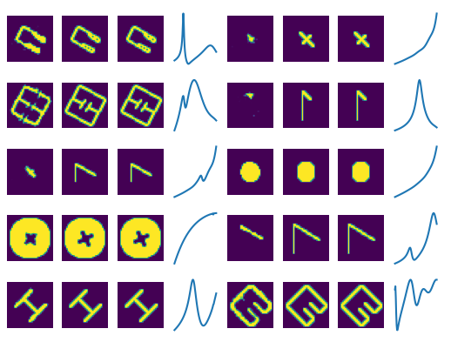
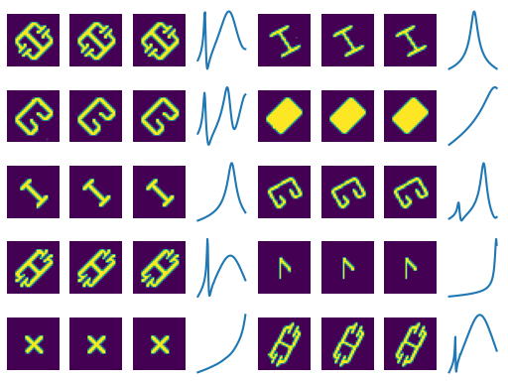
g_loss_pre = g_model.train_on_batch([p_lattent, r_real], p_real)
g_loss_pre = g_model.train_on_batch([p_real, r_real], p_real)
Conclusion:
input the real pattern will disable the response training.
Input random pattern will disable the pattern info.

Slide 2
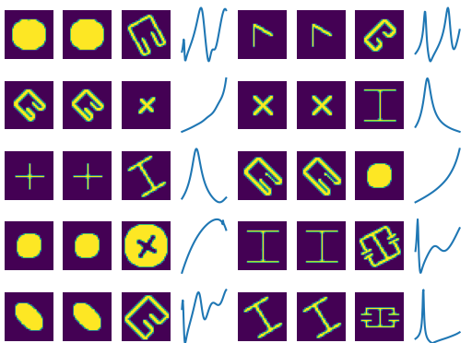
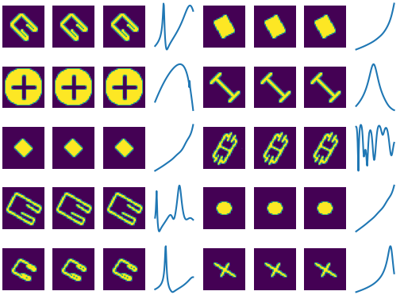
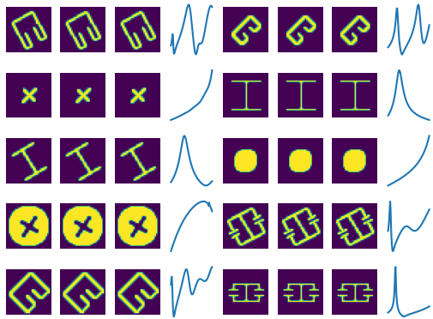
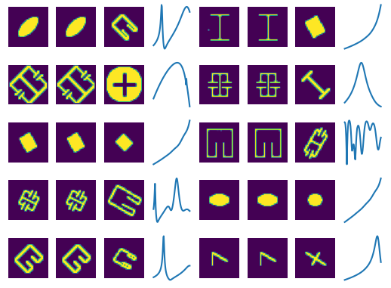
g_loss_pre = g_model.train_on_batch([p_lattent, r_real], p_real), Platten = 0.5Rnd + 0,5 Input
g_loss_pre = g_model.train_on_batch([p_lattent, r_real], p_real), Platten = 0.9 Rnd + 0.1 Input
Conclusion:
0.5 weight wont activate the response
Next step, reduce the latten space defined by the PTL Model

Slide 3
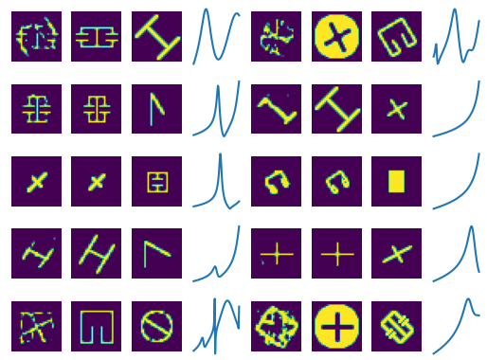
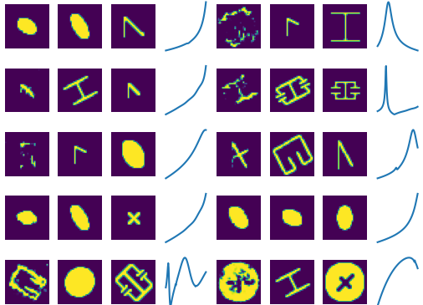
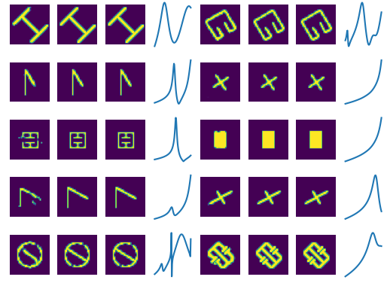
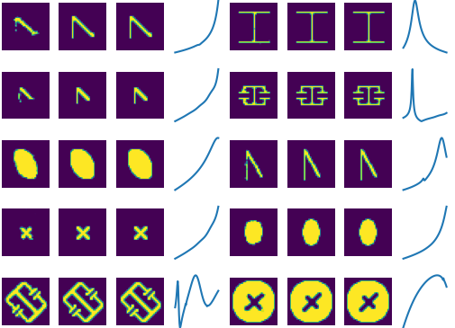
p_lattent = 40->5
p_lattent = 40->2
Conclusion: P latten vector is suitable as 2 or 3

Slide 4
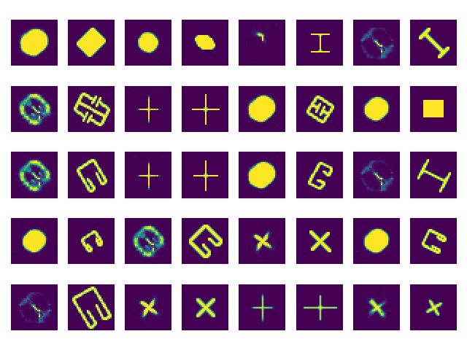
p_lattent = 1, gloss = 0.10

Slide 5
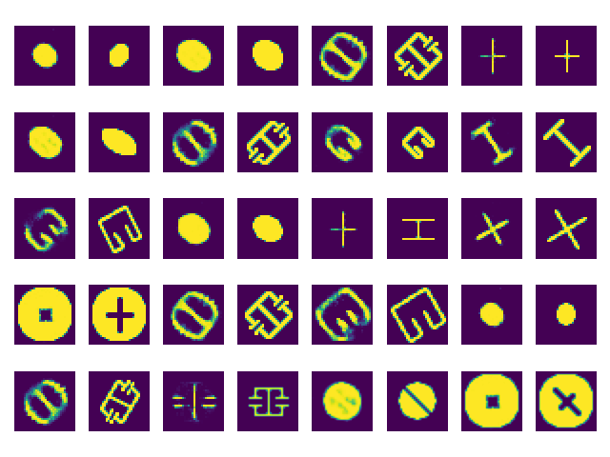
p_lattent = 2, gloss = 0.08, epoch = 100

Slide 6
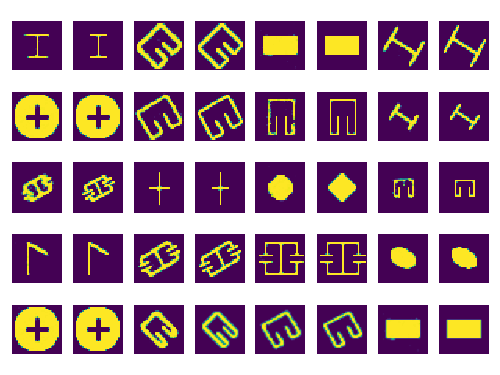
p_lattent = 4, gloss = 0.05, epoch = 100

Slide 7
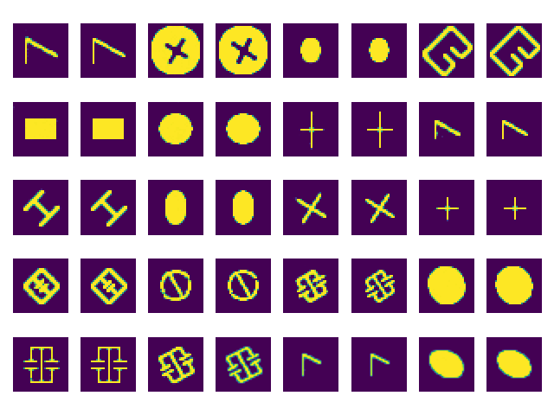
p_lattent = 8, gloss = 0.03, epoch = 100

Slide 8
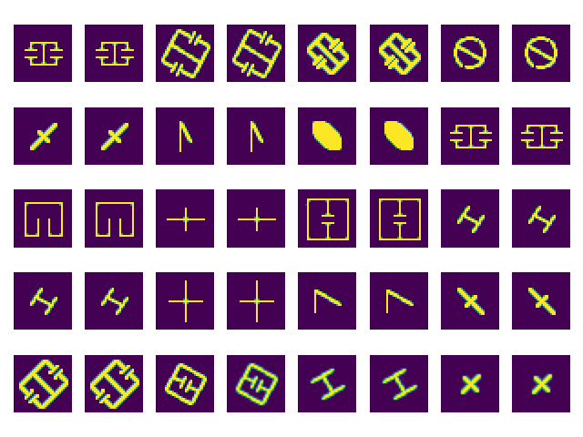
p_lattent = 8, gloss = 0.003, epoch = 1000

Slide 9
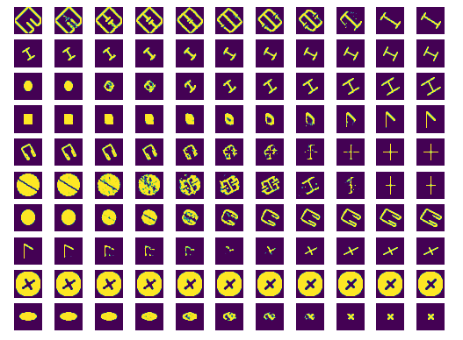
p_lattent = 8, gloss = 0.003, epoch = 1000

Slide 10
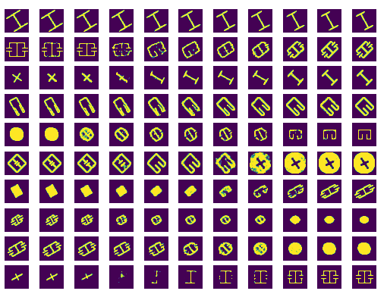
p_lattent = 8, gloss = 0.003, epoch = 1200 (ModelB)

Slide 11
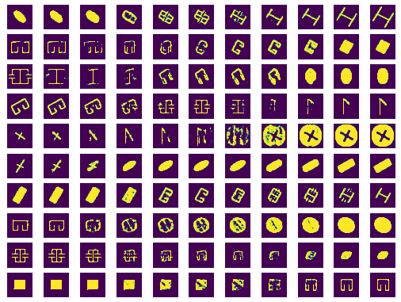
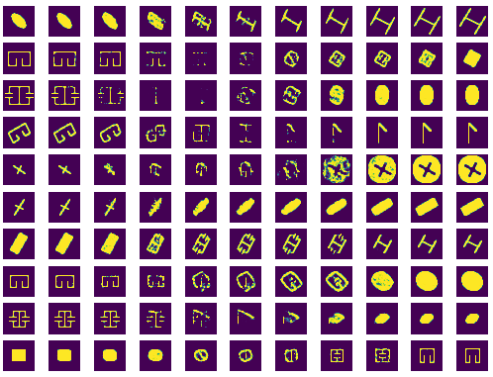
p_lattent = 8, gloss = 0.003, epoch = 1000, two model comparison

Slide 12
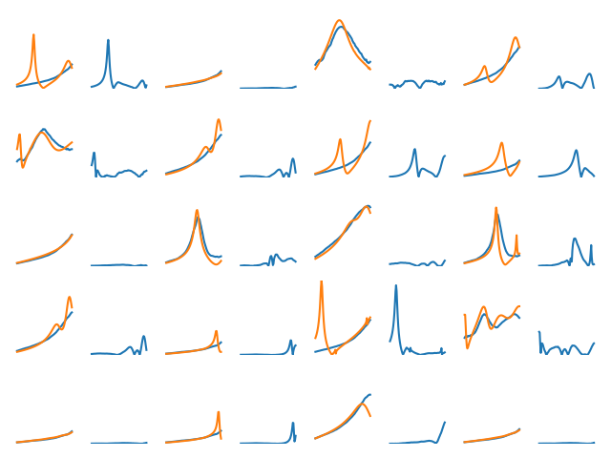
l_lattent = 20, gloss = 0.02, epoch = 4000

Slide 13
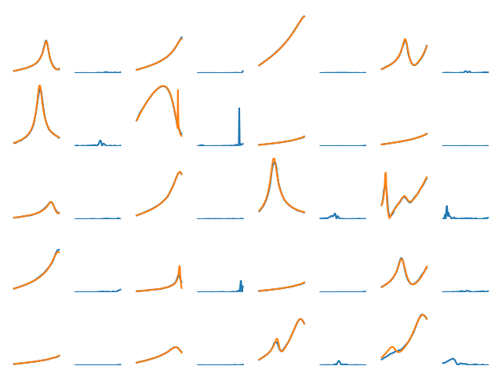
l_lattent = 50, gloss = 0.02, epoch = 4000

